Slide 1
AutoFL: Enabling Heterogeneity-Aware Energy Efficient Federated Learning
Young Geun Kim¹ , Carole-Jean Wu²
MICRO ‘21: MICRO-54: 54th Annual IEEE/ACM International Symposium on Microarchitecture
¹Soongsil University, Korea
²Arizona State University, United States of America
Notes:
在联邦场景下实现异构感知的能耗优化，那么本文实际上是一个优化问题
MICRO 主要关注于微架构

Slide 2
Outline
Introduction
Review of federated learning
Existing approaches to optimize energy
Realistic Execution Environment
System heterogeneity
Stochastic runtime variance
Data heterogeneity
Mechanism to select devices adaptively
Experimental results and analysis
Notes:
在intro部分，主要回顾了联邦学习和一些优化能耗的手段
在实际运行环境部分，主要分析了系统和数据异构，以及运行时间差异的问题
第三部分，介绍了本文的主要工作，即如何对设备进行更好的选择
最后是一些实验的结果分析

Slide 3
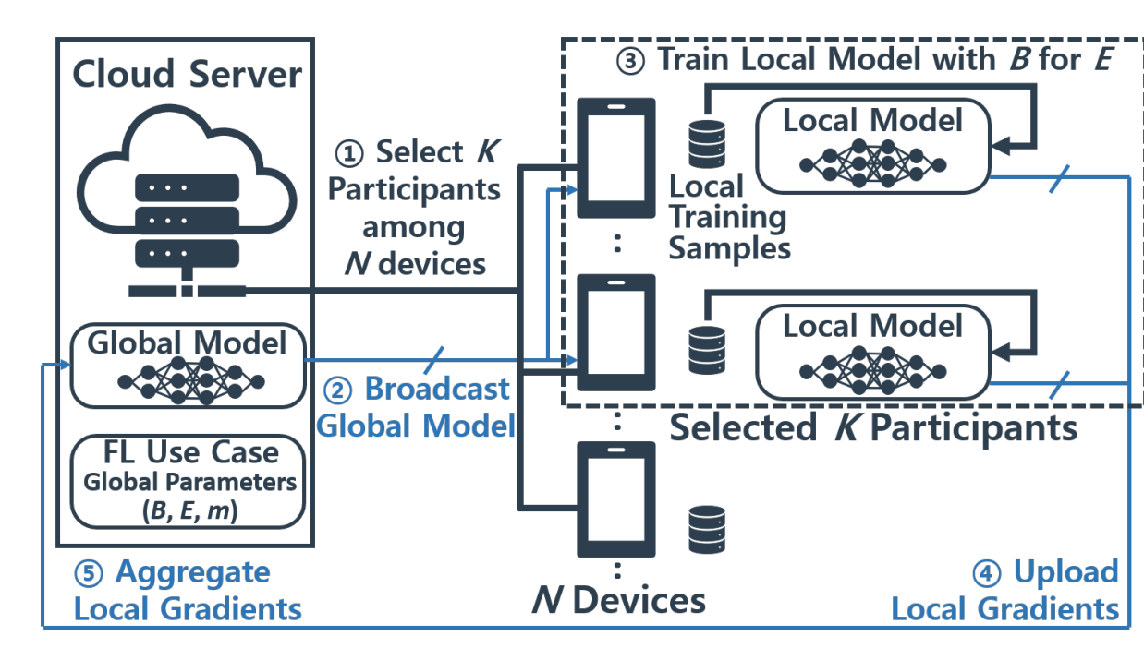
Review of federated learning
B: the local training
minibatch size
E: the number of
local training epochs
K: the number of
participant devices
the straggler problem
Notes:
这个结构就是典型的联邦学习结构。联邦学习本身我就不介绍了，主要介绍一下跟本文优化问题有关的三个参数，就是右边写的这三个：B、E、K

Slide 4
AutoFL: Enabling Heterogeneity-Aware Energy Efficient Federated Learning
Challenges to be addressed
the straggler problem intensifies the time delay and energy consumption
Which K devices to participate in each aggregation round
How to select the execution target(CPU, GPU, DSP, NPU)
Optimization target
maximize the energy efficiency of individual participants (or the cluster of all participants)
Notes:
到了本文的challenges部分，在联邦学习的场景中存在这个straggler problem 木桶效应的问题，短板同时影响着延时和能耗
本文准备从哪些条件去优化这个问题呢，主要就是选择哪K个设备，以及在这些设备上使用什么样的处理器（在fedavg那篇文章中就已经提到目前大多数终端设备都配置了高性能的GPU，那么现在包括麒麟、高通的soc都还包含一个npu，这个东西是专门为机器学习准备的一个计算单元，那么本文虽然在这个部分提到了有这四种计算单元，也有对计算单元选择的工作，但仅限于CPU/GPU，那么NPU实际上潜力还是挺大的，DSP我了解了一下，算力好像还挺有限的，目前应用在机器学习上还比较少）
就如标题所说，本文的优化目标就是功耗。

Slide 5
Existing approaches to optimize energy
System Heterogeneity:
Exclude stragglers(e.g. low-end devices) from aggregation rounds[1]
Allow asynchronous gradient updates[2]
Over-selection and dropping[3]
Tiered gradient compression(e.g. gradient pruning or quantization)[4]
Tiered model sizes[5]
Data Heterogeneity:
Exclude updates from non-IID devices with asynchronous aggregation algorithms[6]
Share data across a subset of devices[7]
warm up the global model with a subset of globally shared data[8]
[1] Andrew Straiton Hard et al. “Federated Learning for Mobile Keyboard Prediction” arXiv: Computation and Language (2018): n. pag.
[2] Marten van Dijk et al. “Asynchronous Federated Learning with Reduced Number of Rounds and with Differential Privacy from Less Aggregated Gaussian Noise..” arXiv: Learning (2020): n. pag.
[3] Malek, Mani et al. “Federated Learning with Buffered Asynchronous Aggregation” (2021).
[4] Jakub Konečný et al. “Federated Learning: Strategies for Improving Communication Efficiency” arXiv: Learning (2016): n. pag.
[5] Sebastian Caldas et al. “Expanding the Reach of Federated Learning by Reducing Client Resource Requirements” arXiv: Learning (2018): n. pag.
[6] Yitao Chen et al. “Exploring the capabilities of mobile devices in supporting deep learning” information security (2019): n. pag.
[7] Yue Zhao et al. “Federated Learning with Non-IID Data..” arXiv: Learning (2018): n. pag.
[8] Moming Duan et al. “Self-Balancing Federated Learning With Global Imbalanced Data in Mobile Systems” IEEE Transactions on Parallel and Distributed Systems (2021): n. pag.
Notes:
45都是在通讯层面降低通讯成本

Slide 6
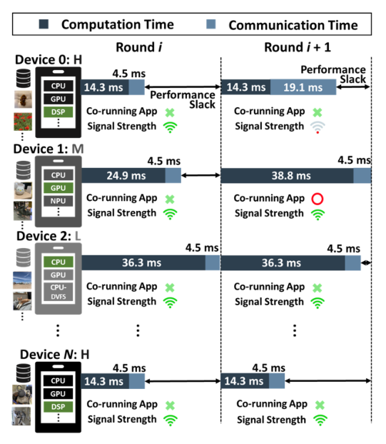
Realistic Execution Environment
System heterogeneity:
the performance of an individual device
high-end, mid-end, low-end smartphone
the availability of co-processors
GPUs, DSPs, or neural processing units (NPUs)
Notes:
然后到实际运行环境部分，他对实际运行环境进行了系统异构、数据异构和随机运行时间变化的分析，这些分析其实都是针对以往的一些理想化的假设下的。
首先是系统异构部分
这里他还考虑了终端设备上DSP GPU NPU之类的设备，但是后面实验部分只做了GPU，还比较了有其他应用负载情况下CPU和GPU的功耗表现，但这个部分的实验也有点问题，后面实验部分再讲

Slide 7
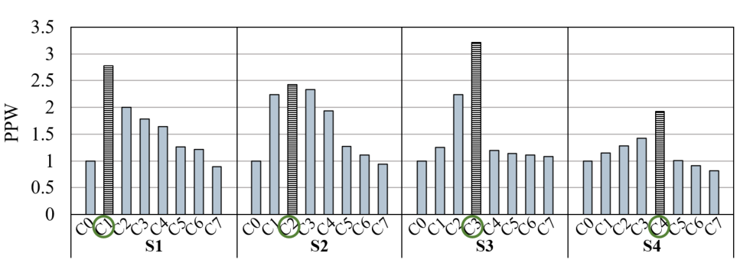
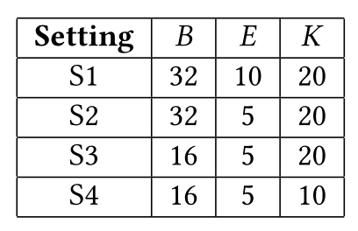
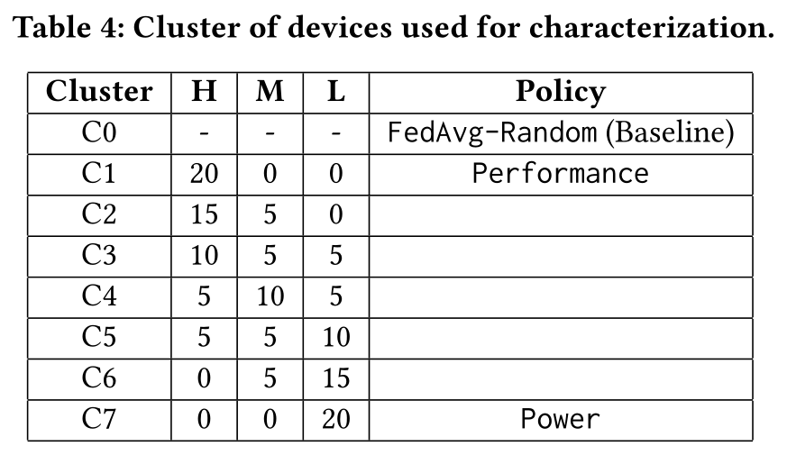
Realistic Execution Environment
Impact of FL Global Parameters and NN Characteristics
CNN-MNIST
PPW: performance per-watt
Global parameter settings
large computation
low computation
Cluster of 20 devices used for characterization
S1: computations are large, high-end devices perform better
S3$→$S4: K$↓$, high-end devices $↓$ is better (stay idle)
Note: consider the computation is large if Batchsize $≥$32, Epoch $≥$10, K $≥$50
small if Batchsize <8, Epoch <5, K <10

Slide 8
Realistic Execution Environment
System heterogeneity:
the performance of an individual device
high-end, mid-end, low-end smartphone
the availability of co-processors
GPUs, DSPs, or neural processing units (NPUs)
Data heterogeneity
Note: only consider the data heterogeneity in data type

Slide 9
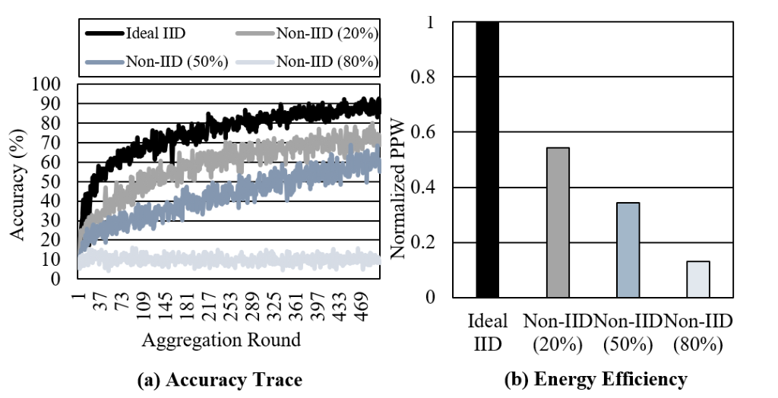
Realistic Execution Environment
Impact of Data Heterogeneity
CNN-MNIST
To guarantee model convergence
Data IID or mitigate data imbalance
Note: Non-IID (M%) means M% of K participant devices have non-IID data

Slide 10
Realistic Execution Environment
System heterogeneity:
the performance of an individual device
high-end, mid-end, low-end smartphone
the availability of co-processors
GPUs, DSPs, or neural processing units (NPUs)
Data heterogeneity
Stochastic runtime variance:
the amount of on-device interference
the amount of Co-running Apps
the execution conditions
network signal strength
Notes:
看两个橙色框框

Slide 11
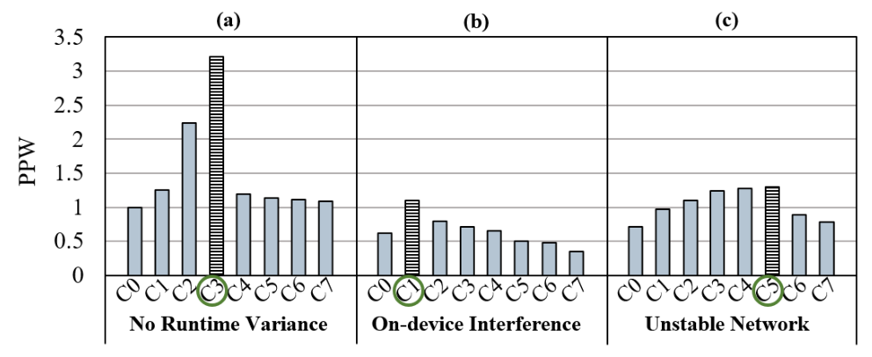
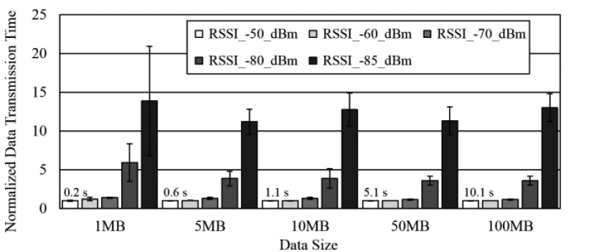
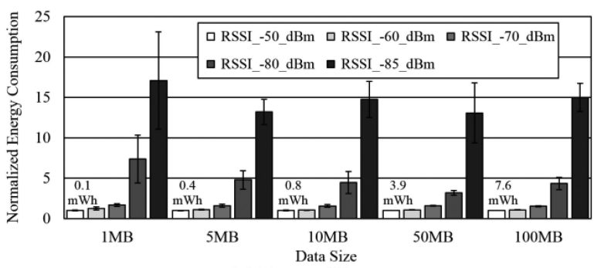
Realistic Execution Environment
Impact of Runtime Variance
Cluster of 20 devices used for characterization
(a)$→$(b) : On-device Interference$↑$, c3 $→$c1, high-end devices perform better
(a)$→$(c) : Network stability$↓$, c3 $→$c5, low-end devices perform better
Notes:
有其他应用负载情况下，高端处理器表现更好，因为绝对性能更强
网络不稳定情况下，瓶颈主要已经在通讯时间上了，所以低端设备表现更好
下面的图是不同网络状况下的传输时间和传输功耗，信号不好的情况下功耗会大幅增加。

Slide 12
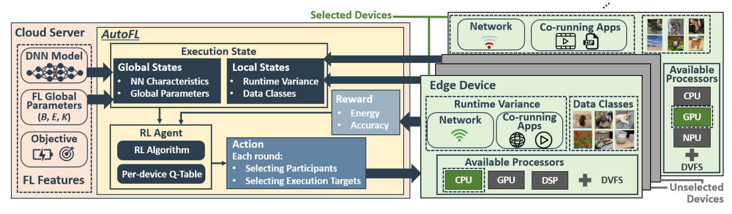
AutoFL: an adaptive prediction mechanism
Overview
Global States: NN Characteristics, Global Parameters
Local States: Runtime Variance, Data Classes
Reward: Energy efficiency, Accuracy

Slide 13
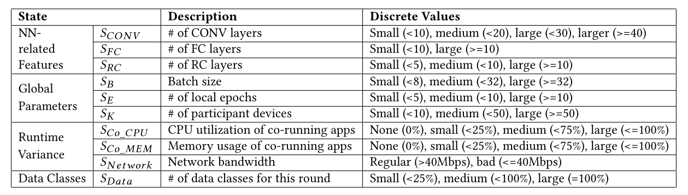
AutoFL: an adaptive prediction mechanism
State:
Global states
Local states
Action:
Global action: the selection of participant devices
Local action: the selection of on-device execution targets available for training execution, such as CPUs, GPUs, or DSP
Note: $S_{data}$ represents the number of data classes that each device has
the global states of all devices remains unchanged throughout the training
Notes:
Q-learning的三个主要部分：State, Action, Reward

Slide 14
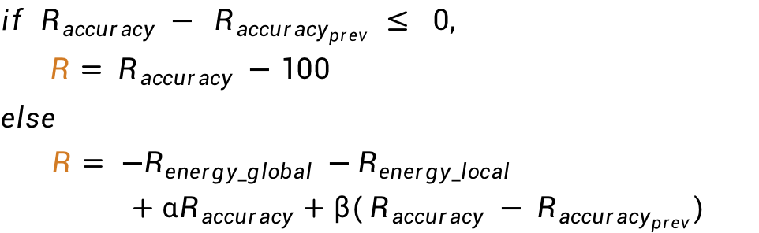
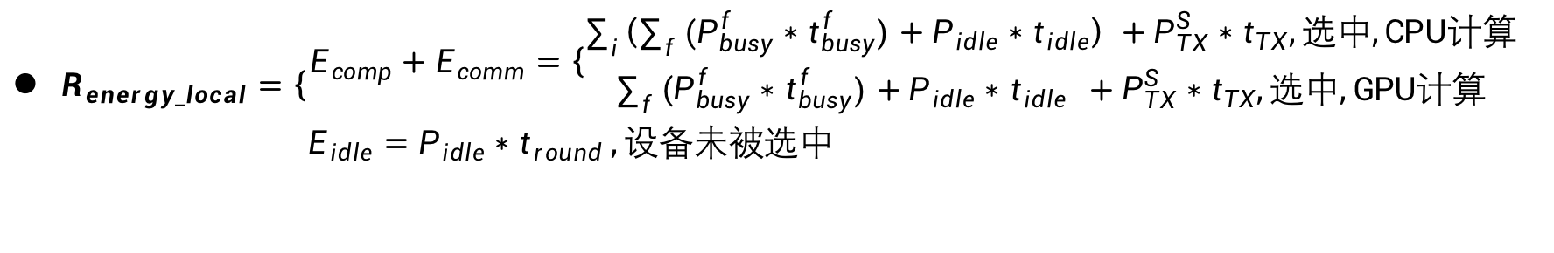
AutoFL: an adaptive prediction mechanism
Reward:
$R_{energy_local}=\left\{\begin{aligned}E_{comp}+E_{comm}=\left\{\begin{aligned}\sum_{i}{\left(\sum_{f}{{(P}_{busy}^{f}∗t_{busy}^{f})+P_{idle}∗t_{idle}}\right) +P_{TX}^{S}∗t_{TX},选中,CPU计算} \\ \sum_{f}{{(P}_{busy}^{f}∗t_{busy}^{f})+P_{idle}∗t_{idle}} +P_{TX}^{S}∗t_{TX},选中,GPU计算\end{aligned}\right. \\ E_{idle}=P_{idle}∗t_{round} ,设备未被选中 \end{aligned}\right.$
$R_{energy_global}=\sum{R_{energy_local}}$
$R_{accuracy}$ (the model accuracy )
$if{ R}_{accuracy} −{ R}_{accuracy_{prev}} ≤ 0,$
$R= R_{accuracy} −100$
$$else$$
$R= {−R}_{energy_global} −R_{energy_local}$
$+ αR_{accuracy}+β({ R}_{accuracy} −{ R}_{accuracy_{prev}})$
Note: the accuracy is the global accuracy, ignore the local accuracy

Slide 15
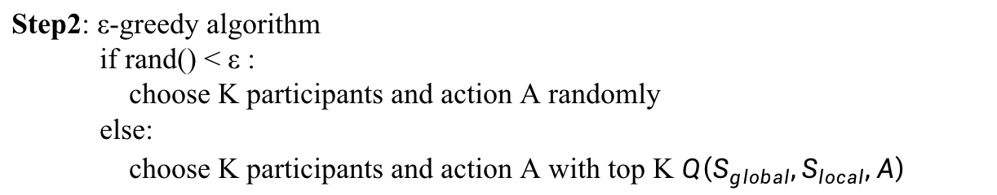
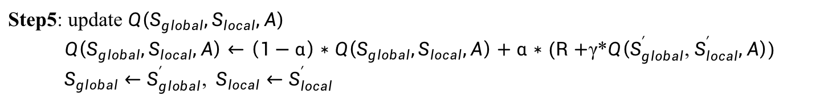
AutoFL: an adaptive prediction mechanism
Training the Q-learning model
Step1: Initialize $Q\left(S_{global},S_{local},A\right)$ randomly
Step2: ε-greedy algorithm
if rand() < ε :
choose K participants and action A randomly
else:
choose K participants and action A with top K $Q\left(S_{global},S_{local},A\right)$
accelerate convergence
improve fairness
Step3: Training
Step4: Estimate and calculate reward $R$, and the new $S_{global}^{′}$, $S_{local}^{′}$
Step5: update $Q\left(S_{global},S_{local},A\right)$
$Q\left(S_{global},S_{local},A\right)←\left(1−α\right)∗Q\left(S_{global},S_{local},A\right)+α∗(R+$γ*$Q\left(S_{global}^{′}\text{, }S_{local}^{′},A\right))$
$S_{global}←S_{global}^{′}$, ${ S}_{local}←S_{local}^{′}$
Step6: if the accuracy achieves the global target accuracy, then finish the training
else back to Step2

Slide 16
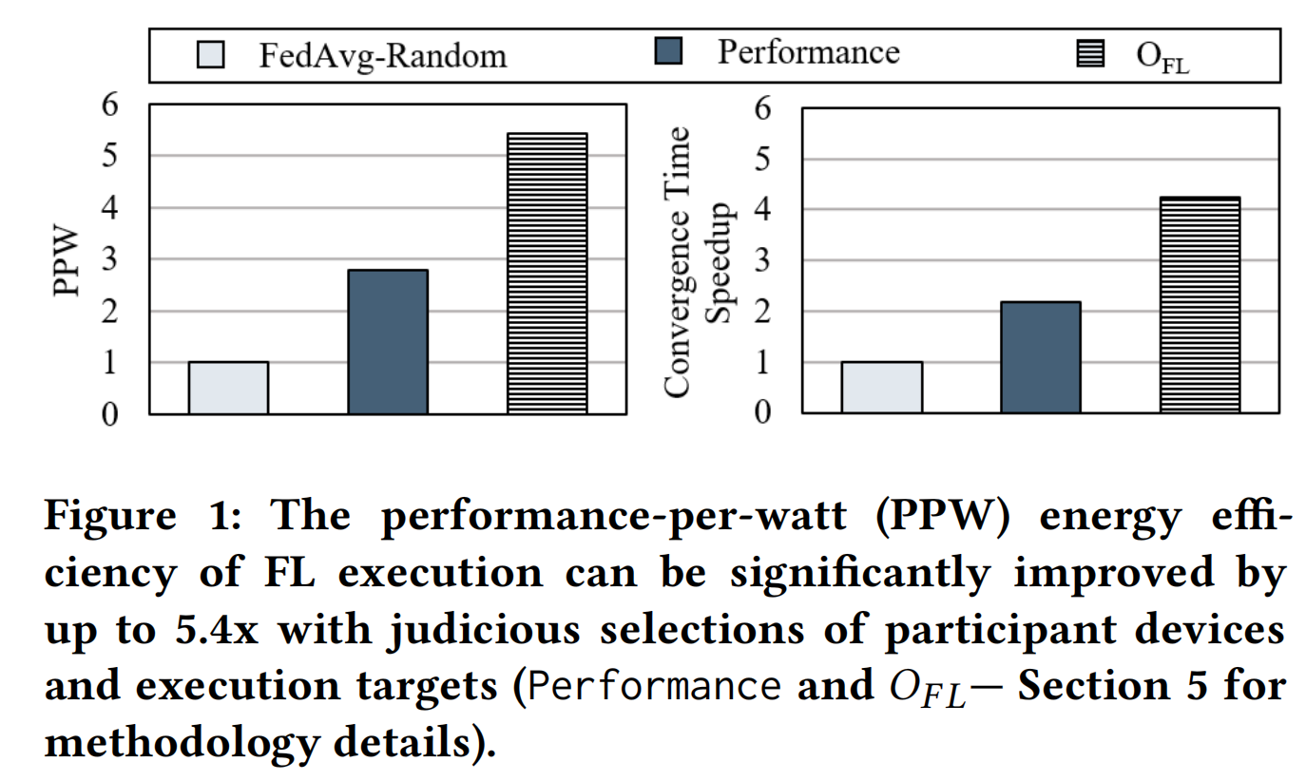
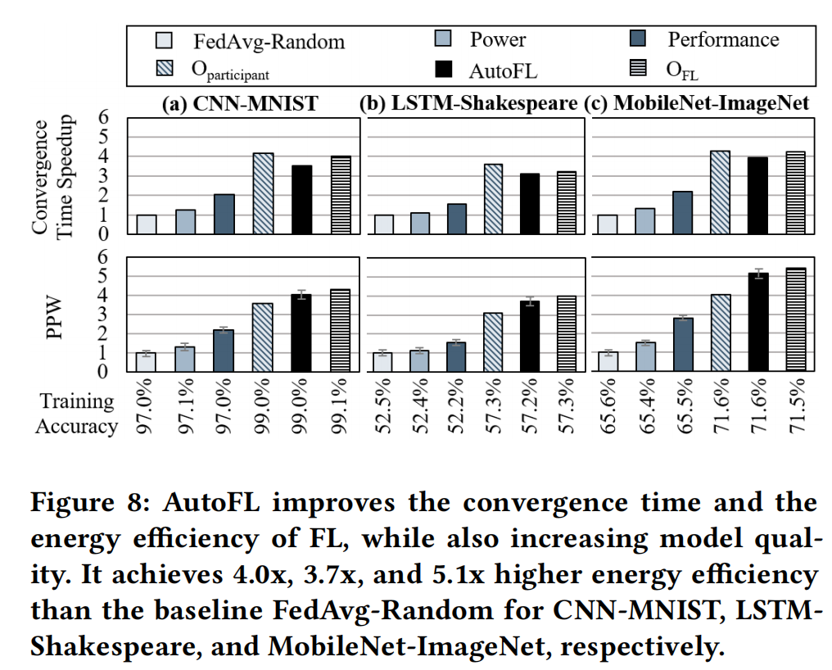
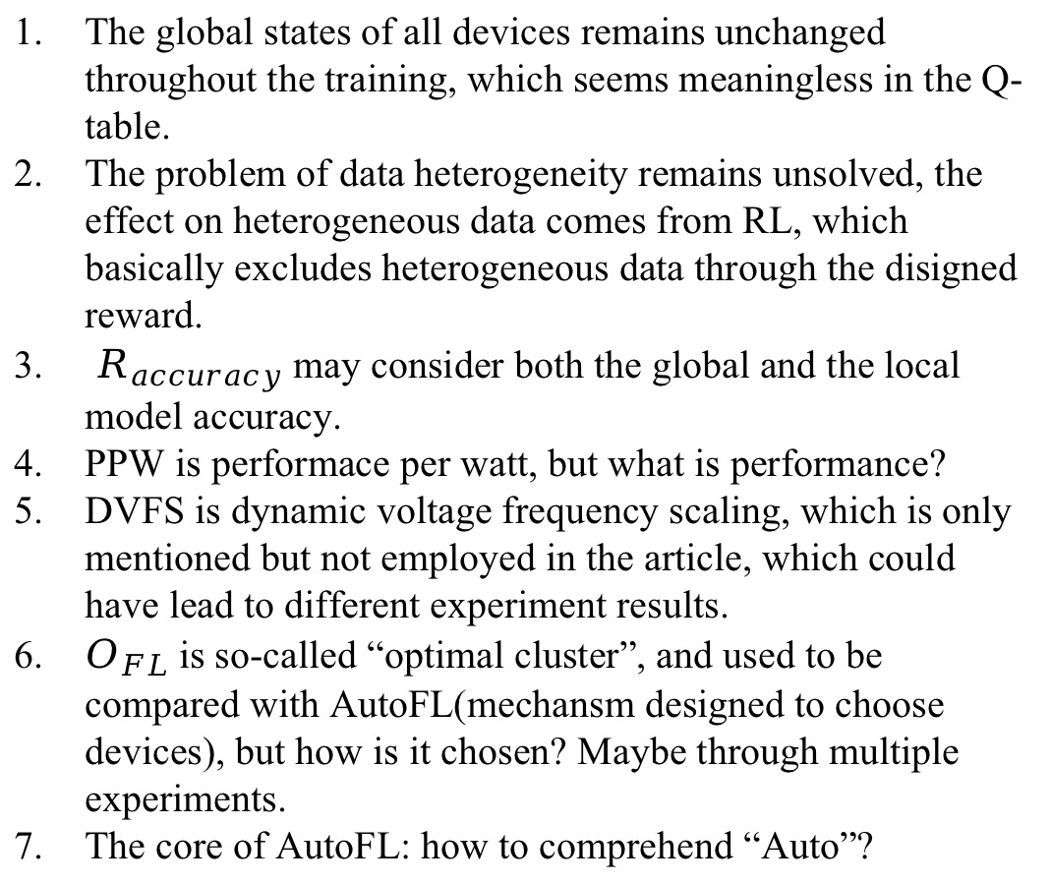
Question
The global states of all devices remains unchanged throughout the training, which seems meaningless in the Q-table.
The problem of data heterogeneity remains unsolved, the effect on heterogeneous data comes from RL, which basically excludes heterogeneous data through the disigned reward.
$R_{accuracy}$ may consider both the global and the local model accuracy.
PPW is performace per watt, but what is performance?
DVFS is dynamic voltage frequency scaling, which is only mentioned but not employed in the article, which could have lead to different experiment results.
$O_{FL}$ is so-called “optimal cluster”, and used to be compared with AutoFL(mechansm designed to choose devices), but how is it chosen? Maybe through multiple experiments.
The core of AutoFL: how to comprehend “Auto”?
Notes:
PPW为什么没有定义？这个Performace到底是准确率还是每轮的计算时间。这篇文章里PPW都是以“归一化”的形式给出的，所以我认为这玩意就是拿功耗和时间乘积的倒数算出来的
文中提了DVFS，但是没有实际部署情况，实际上不知道他准备在什么层面实现这个东西，因为这个东西不说在苹果设备上，就算在安卓设备上也很难实现，因为处理器调度往往是系统级权限
为什么不是高端处理器在所有任务下更优？因为通信成本不变，低负载下计算负载不再是瓶颈；也许根据负载情况，动态调整会是一种优化方向（电压是不可能动的了，只能通过降低负载让系统不要把频率拉的太高）
同时还是调度问题，即使把高端处理器降频到和低端处理器同样的性能，其能耗比也会遥遥领先
如何理解auto？就是放进state里的东西都能自适应，任何模型，任何网络状况，任何终端设备状况，这个机制都能自适应，不用重新部署设备选择算法。

Slide 17
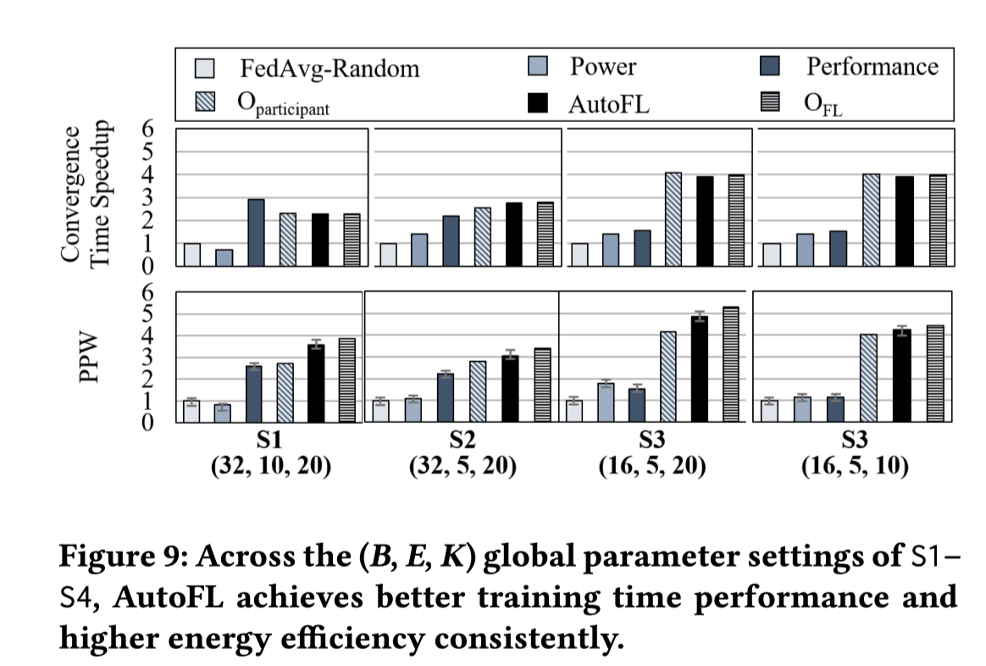
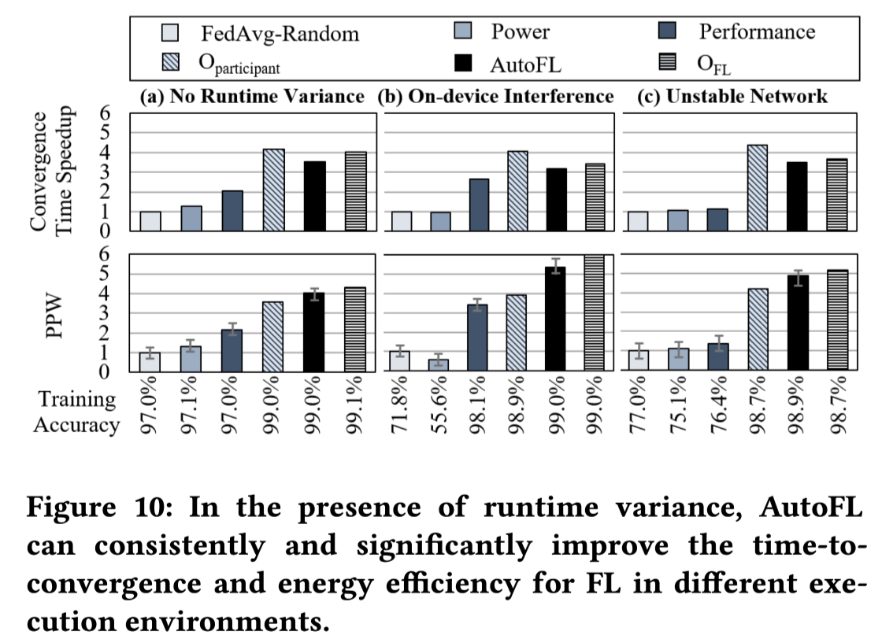
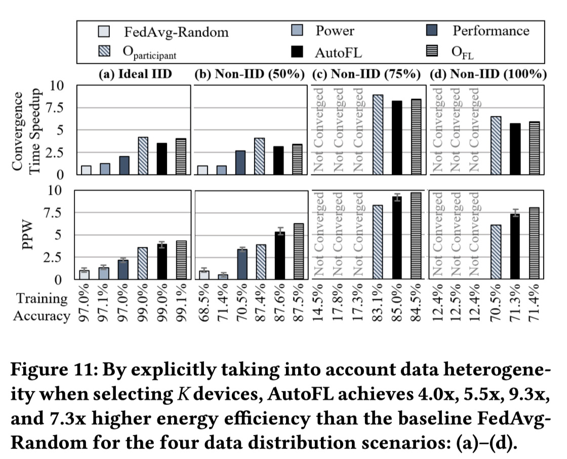
Experimental results and analysis
1. Adapative to global parameters, stochastic varience and data heterogeneity.
2. In the absence of runtime variance, CPU exhibits better energy efficiency than GPU. On the other hand, when on-device interference exists, the optimal execution target usually shifts from CPU to GPU, as the CPU performance is degraded due to
1) the competition for CPU time slices and cache
2) frequent thermal throttling.
Notes:
关于CPU和GPU的结论跟他模拟的co-running apps有关（模拟的网页浏览）

Slide 18
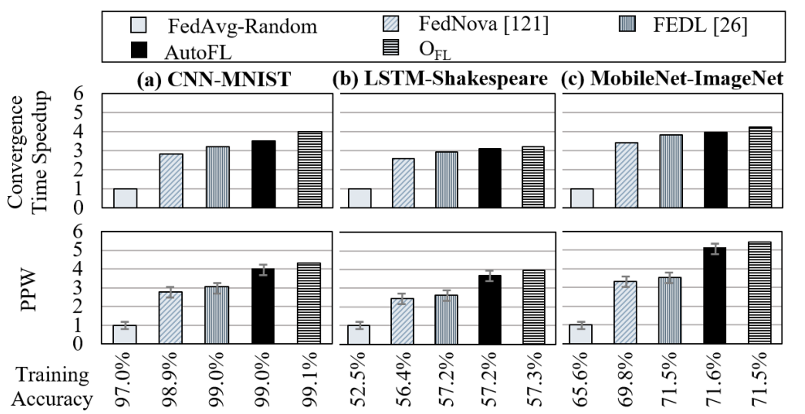

Experimental results and analysis
$O_{FL}$: the optimal policy
Compared with FedNova and FEDL, AutoFL achieves better convergence time and energy efficiency.

Slide 19
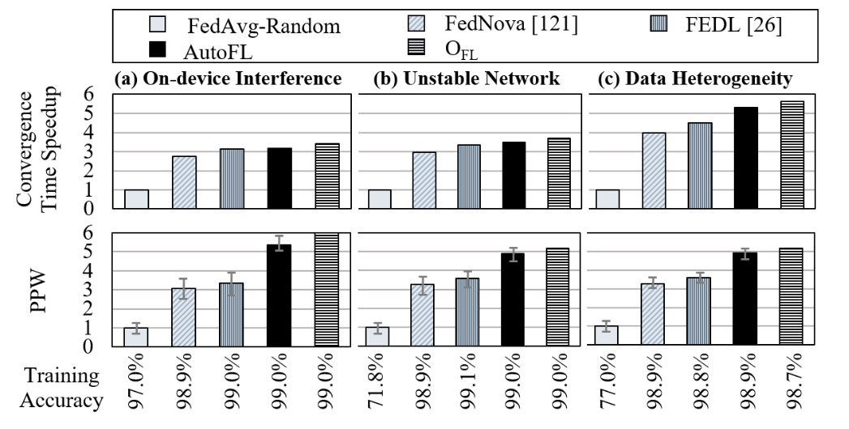
Experimental results and analysis
AutoFL outperforms both FedNova and FEDL,
even in the presence of runtime variance(a)(b) and data heterogeneity(c).
Notes:
在不同模型和不同的条件和FedNova和FEDL比了一下，效果都更好

Slide 20

Thank you!

